Slide 1
Welcome to Arbonne and Healthy Habits for Life!
1

Slide 2
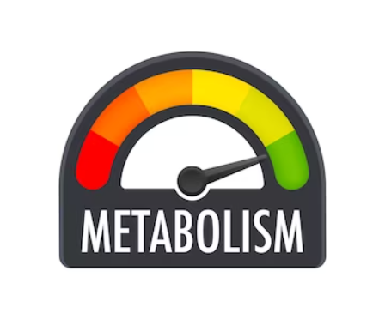
Metabolism what is it? Do I have one?
2

Slide 3
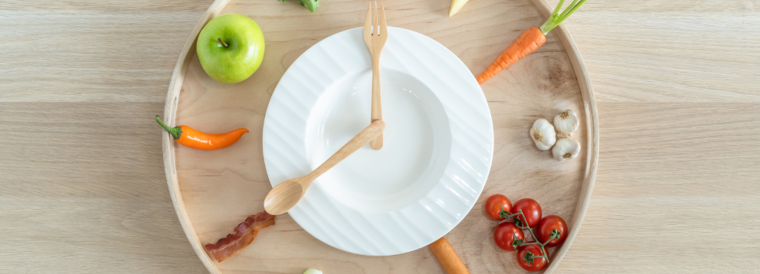
Metabolism: Fat or Sugar Burning?
The body can burn sugar or fat for energy, but the body’s default position is sugar burning.
2
3

Slide 4
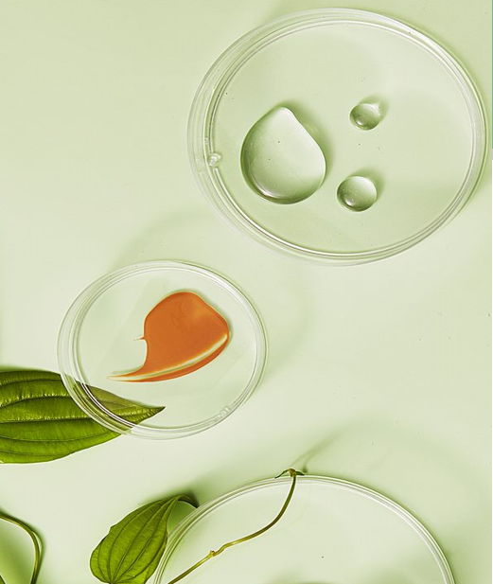
Our Brand Promise
Clean Products
Certified Gluten Free, Vegan, non-GMO
No artificial colors, flavors or sweeteners
Never tested on animals
Arbonne sets the standard…
Continually striving to eliminate ingredients that are damaging to the environment and going far beyond the norm by banning over 2000 harmful ingredients. Our products give REAL HEALTH BENEFITS with HIGH IMPACT RESULTS!
4

Slide 5
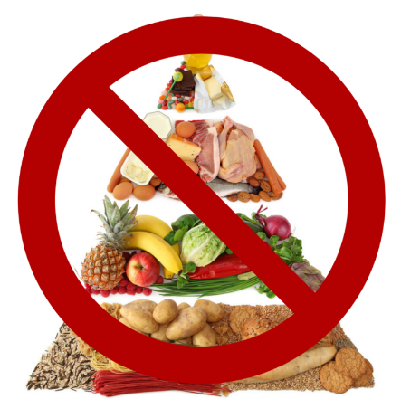
But I Eat Healthy!!!
The current Standard America Diet (SAD) is built on the “food pyramid” and is build on 6—11 daily servings of bread, cereal, rice and pasta.
In 1950 America consumed 2 pounds of sugar annually per person, today it is 150 pounds!
http://.healthy-diet-healthy.you.com/new
food pyramid.html
5

Slide 6
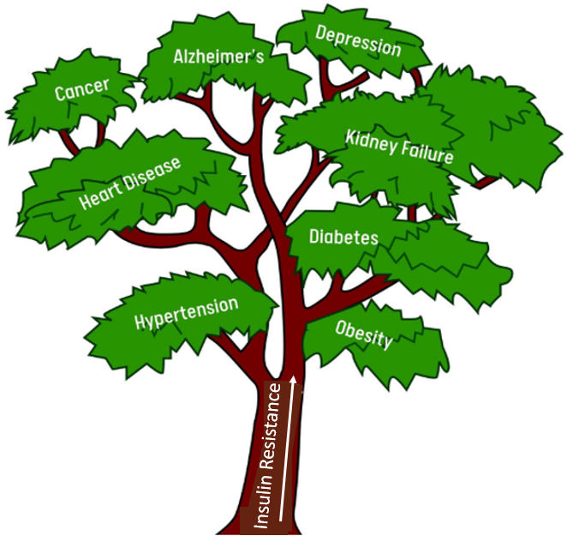
Sugar and Grain Rich S.A.D. = Insulin Resistance
6

Slide 7
Am I Insulin Resistant?
8

Slide 8
Getting Started—For the Next Two Weeks
Step 1: Don’t eat after dinner for 12 hours. IMPORTANT: Break your fast with fat and protein such as an avocado in a protein shake.
Step 2: Eat No sugar (no honey, agave, syrup, etc.), and no grains (wheat, oats, rice)
Step 3: Keep daily net carbs from 20g to no more than 50g (this works to shift your metabolism to fat burning).
Step 4: Eat whole foods one ingredient -think broccoli), and good fats (avocado, coconut oil butter and olive oil
7

Slide 9
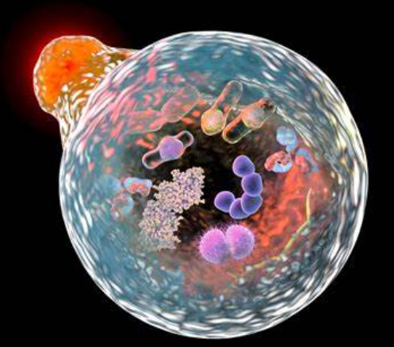
What is Autophagy?
Built in Body Cleansing for Waste
9

Slide 10
Cells Need to be Constantly Replaced
Age makes cells less efficient, and older cells can be cleaned out and
replaced by new healthy ones.
Autophagy is the process by which cells are destroyed, damaged
components eliminated, and healthy parts reused as new building
materials for repair and regeneration.
10

Slide 11
Fasting 17+ Hours
How to
Induce Autophagy
Ignite Fat Burning Metabolism
Add Resistance Exercise
11

Slide 12
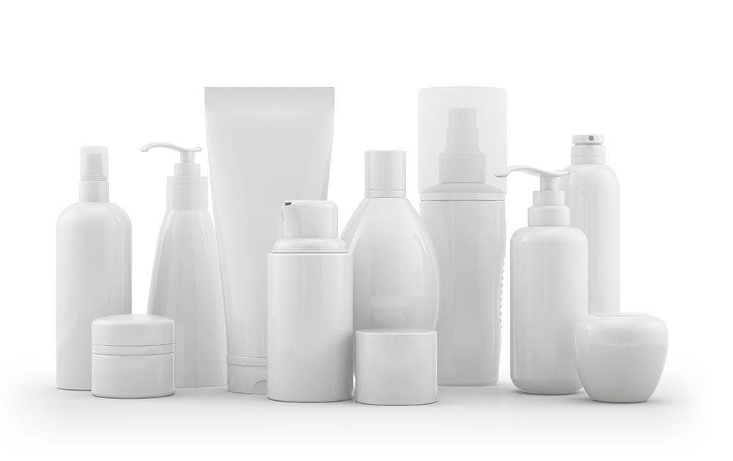
Let’s talk about OBESOGENS!
Obesogens are in almost all of the products we use today!
12

Slide 13
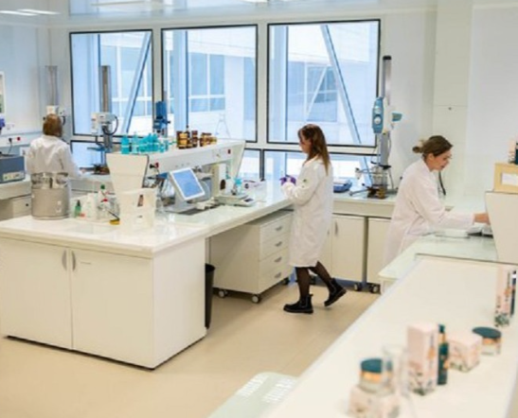
ARBONNE is the world leader in CLEAN PERSONAL CARE PRODUCTS
Arbonne strives to go beyond clean, with the elimination of 2,000 toxic ingredients!
Our Ingredient Policy
We develop each product with meaningful ingredients, continuously raising the standards to find the perfect balance between plant-based, bio-based, and scientifically derived ingredients..
13

Slide 14
ARBONNE RESULTS
14

Slide 15
ARBONNE RESULTS
No Sugars
No Grains
Nothing after dinner
for 12 hours
4. Break your fast with Arbonne Protein
“Get rid of sugars and grains and see what happens.”
15

Slide 16
ARBONNE RESULTS
16

Slide 17
ARBONNE RESULTS
At 64 Years
And then at 74 Years
17

Slide 18
Dr. Deana Holdren on regaining and supporting our metabolic health
Link: https://vimeo.com/919228016
18

Slide 19
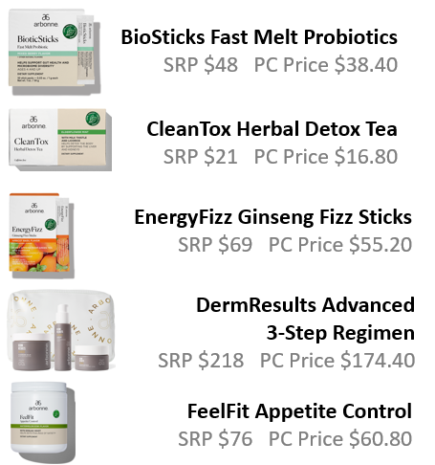
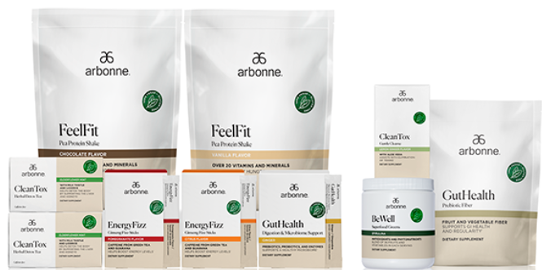
PREFERRED CLIENT SPECIALS
$29 Sign-Up Fee – Save 20% and More for 1 Year
Recommended Add-Ons
30 Days to Healthy Living Set
Retail $555
Your Preferred Client Price $333
PLUS- Choose a Free Gift from the Free Product List
19

Slide 20
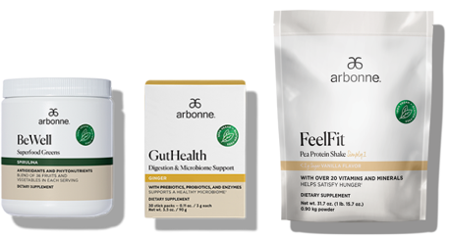
PREFERRED CLIENT SPECIALS
$29 Sign-Up Fee – Save 20% and More for 1 Year
Recommended Add-Ons
Healthy Habits for Life
Retail $215
Your Preferred Client Price $172
PLUS- Choose a Free Gift from the Free Product List
20

Slide 21
PREFERRED CLIENT SPECIALS
$29 Sign-Up Fee – Save 20% and More for 1 Year
Recommended Add-Ons
Daily Gut Reset
Retail $189
Your Preferred Client Price $151.20
PLUS- Choose a Free Gift from the Free Product List
21

Slide 22
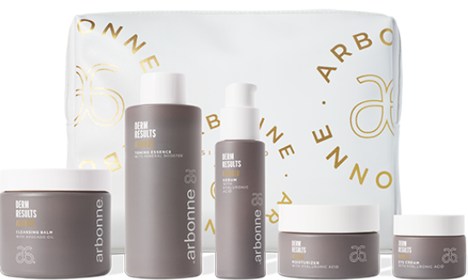
PREFERRED CLIENT SPECIALS
$29 Sign-Up Fee – Save 20% and More for 1 Year
Recommended Add-Ons
DermResults Advanced 5- Step Regimen
Retail $351
Your Preferred Client Price $280.80
PLUS- Choose a Free Gift from the Free Product List
22

Slide 23
3 ways to Win with Arbonne
PREFERRED CLIENT-$29
Eligible to join with your very first order
20% - 30% and more every time you shop
Free shipping with qualifying order
Free product with qualifying order
23

Slide 24
3 ways to Win with Arbonne
Host / Brand Ambassador
Host and get the best discounts
Become a Brand Ambassador get
paid every time someone you refer purchases
35% discount on all your purchases
Earn enough from just referring to pay for your orders and more
18
24

Slide 25
3 ways to Win with Arbonne
Brand Partner
35% to 45% discount
Earn 15% on your PC’s purchases – paid weekly
Earn commissions and overrides on your team up to 18%
Run your global business from your phone wherever you are, or virtually
24

